Slide 2

Power BI / FABIC
Licensing
made simple
Notes:
Photo by NeONBRAND on Unsplash

Slide 3

Trust, but verify.
Ronald Regan
Notes:
Photo by Cytonn Photography on Unsplash

Slide 4
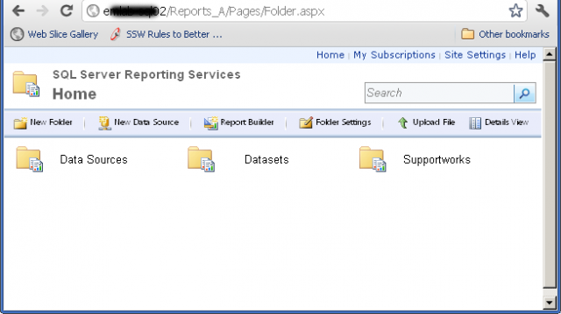

Slide 5


Slide 6
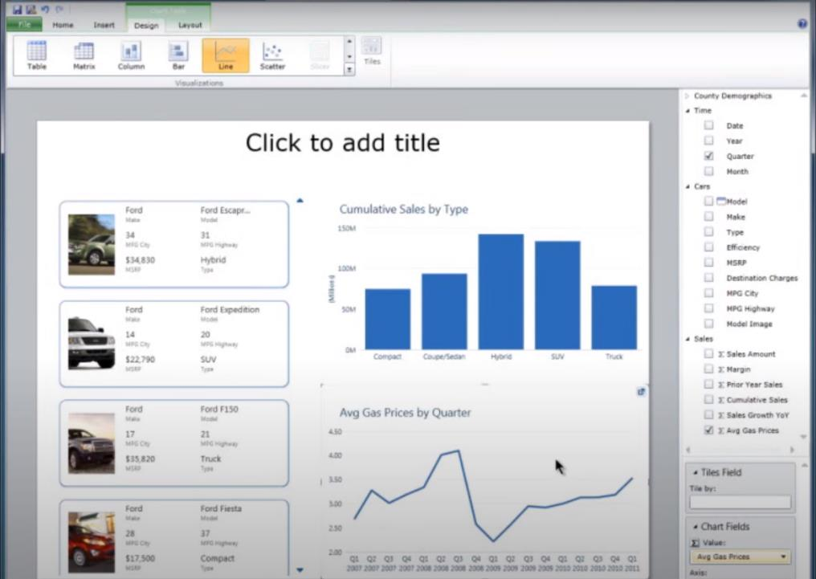

Slide 7

Notes:
Photo by Mari Helin on Unsplash

Slide 8

Notes:
Photo by Jakob Boman on Unsplash
No choice I had dive and start exploring

Slide 9

This Photo by Unknown Author is licensed under CC BY-NC-ND

Slide 10


Slide 11

Notes:
Photo by Nghia Le on Unsplash

Slide 12

Notes:
Photo by Emily Morter on Unsplash
What do I mean by an SME?

Slide 13
Definition
Small to Medium Enterprise
Headcount < 250 people
Turn over <= £25 million
https://en.wikipedia.org/wiki/Small_and_medium-sized_enterprises

Slide 14
99.3%
“The Department for Business Innovation and Skills estimated that at the start of 2014, 99.3% of UK private sector businesses were SMEs” https://en.wikipedia.org/wiki/Small_and_medium-sized_enterprises#United_Kingdom

Slide 15

Notes:
Photo by Matthew Henry on Unsplash

Slide 16

Notes:
Photo by Ryan Franco on Unsplash

Slide 17

Notes:
Photo by Andrea Piacquadio from Pexels

Slide 18

Notes:
Photo by Diana Parkhouse on Unsplash

Slide 19

Notes:
Photo by <a href="https://unsplash.com/@rossfindon?utm_source=unsplash&utm_medium=referral&utm_content=creditCopyText">Ross Findon</a> on <a href="https://unsplash.com/photos/mG28olYFgHI?utm_source=unsplash&utm_medium=referral&utm_content=creditCopyText">Unsplash</a>

Slide 20


Slide 21
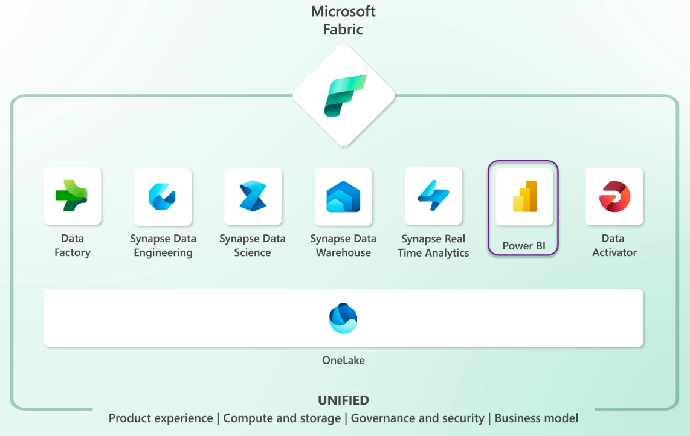

Slide 22


Slide 23


Slide 24

Notes:
What is the goal of this presentation?

Slide 25

Notes:
Give the user a full overview of all the licence options available to Power BI
From Microsoft and third parties
So will be more a broad brush overview of the entire landscape.
Also some of the options ARE NOT THAT OBVIOUS

Slide 26

Notes:
Photo by Alexandra Georgieva from Pexels
Some parts of this presentation are going to be rather shallow

Slide 27

Notes:
Photo by Camylla Battani on Unsplash
Chances you will leave the presentation with some answers, which will lead to more questions

Slide 28


Good
Bad
Notes:
We will cover both the Good and Bad aspects of each option as I see them, feel free to disagree

Slide 29


Slide 30


Slide 31


Notes:
Photo by William White on Unsplash
This is now call a Fabric licence

Slide 32



Slide 33


Power BI Premium Per User
Notes:
Power Bi Per User Licence
Photo by Papaioannou Kostas on Unsplash

Slide 34

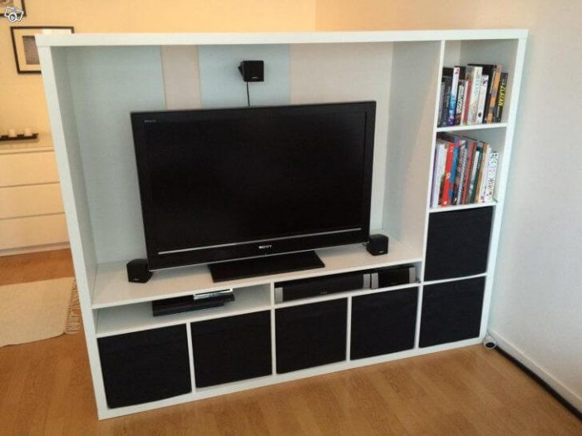
Power BI Embedded
Notes:
https://enthusiasthome.com/diy-entertainment-center/

Slide 35


Power BI Premium
Notes:
Photo by Jp Valery on Unsplash

Slide 36


Notes:
Photo by Diana Parkhouse on Unsplash

Slide 37

Robert French
Data Shepherd,
Data Plumber ,
Data Dance Teacher
Email -
Robert.French@qnrl.com
@sqlbobscot
#DressUpFriday
Linked In - https://www.linkedin.com
/in/rwlpfrench/
Website - https://www.qnrl.com/

Slide 38

Notes:
Photo by Romain Vignes on Unsplash
First we have to explain some terms

Slide 39

Notes:
Photo by Jan van der Wolf: https://www.pexels.com/photo/blue-road-sign-with-arrow-9881346/
Before talk about the types of lience
There are two

Slide 40

Notes:
First though there are two BROAD types of license
Photo by Waldemar Brandt on Unsplash

Slide 41
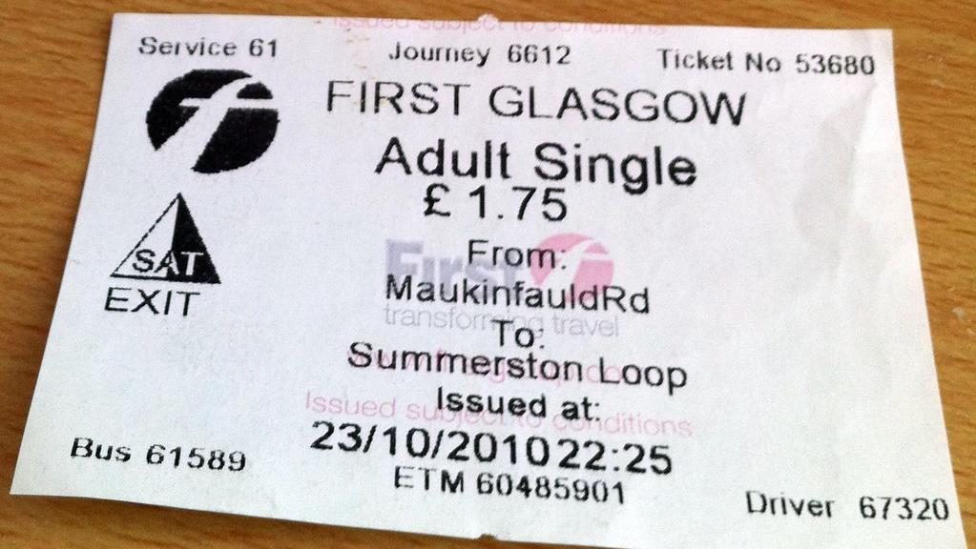
User license
Notes:
Personal license – to allow anyone to ride on a bus in Glasgow you have purchase a ticket, this could be a season ticket so you can ride at any time. Only one person at a time can use that ticket though

Slide 42
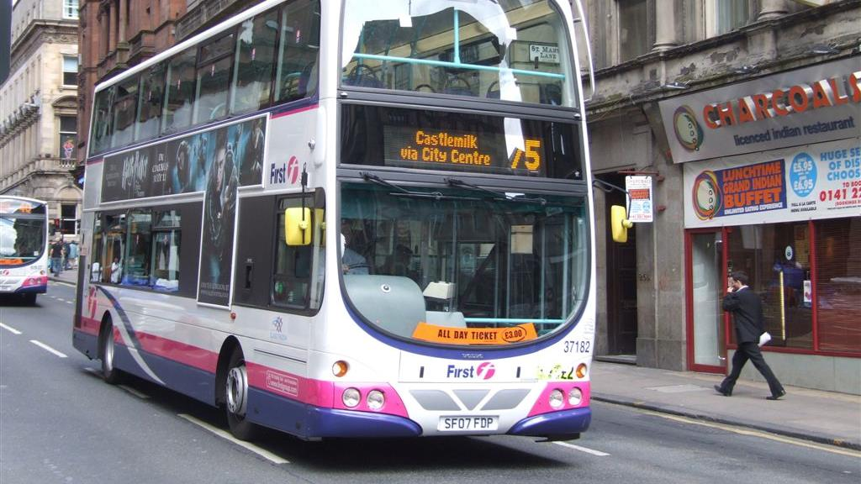
Capacity License
Notes:
What if your company wants to transport 60, or 100 people regularly. More people it becomes cheaper to rent the entire bus

Slide 43
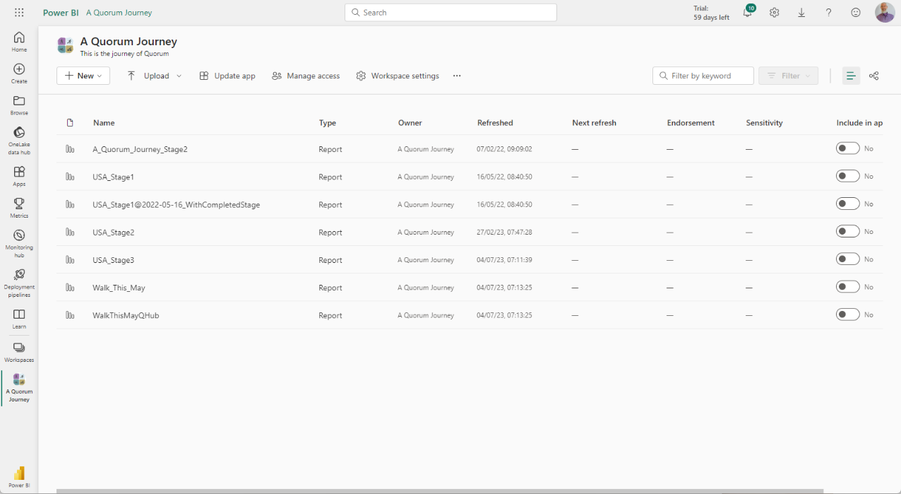

Slide 44
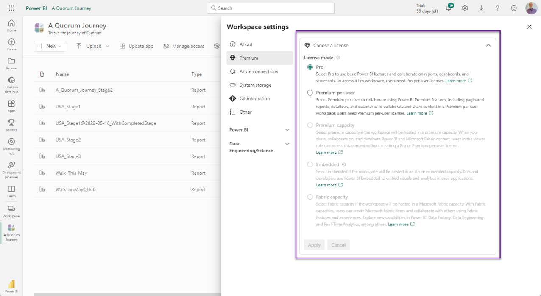

Slide 45
Notes:
Photo by William White on Unsplash

Slide 46
Notes:
What are the upsides of Power BI Free

Slide 47
User license
Notes:
Personal license – to allow anyone to ride on a bus in Glasgow you have purchase a ticket, this could be a season ticket so you can ride at any time. Only one person at a time can use that ticket though

Slide 48

Free to download and use

Slide 49
Cost = £0.00p

Slide 50
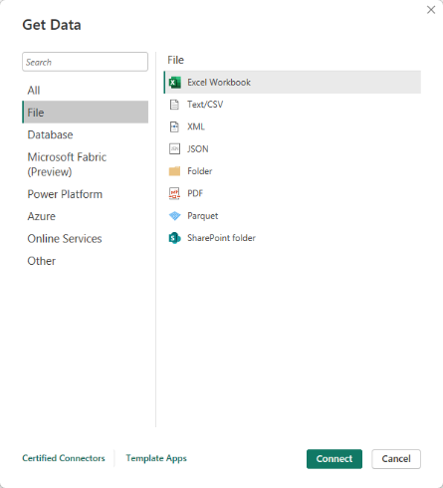
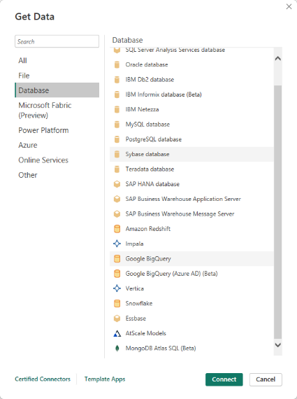
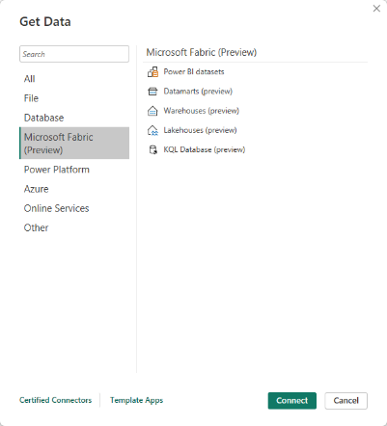
Notes:
Can import data from a wide variety of sources 100+
1/3

Slide 51
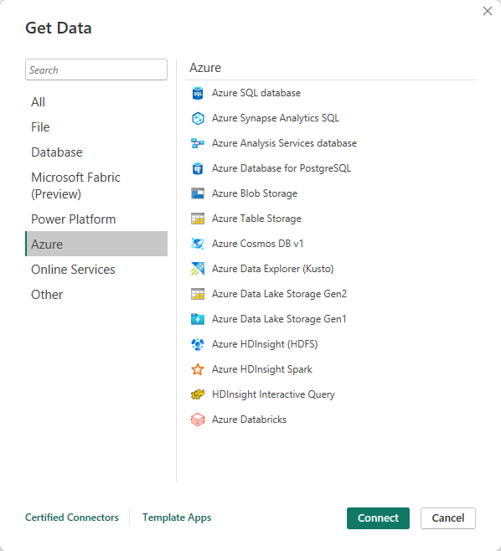
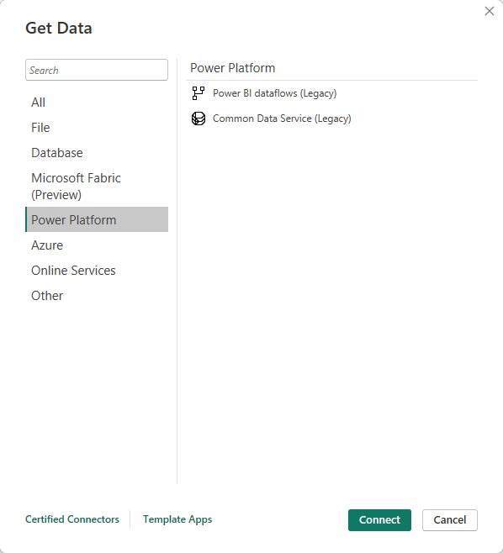
Notes:
Can import data from a wide variety of sources 100+
2/3

Slide 52
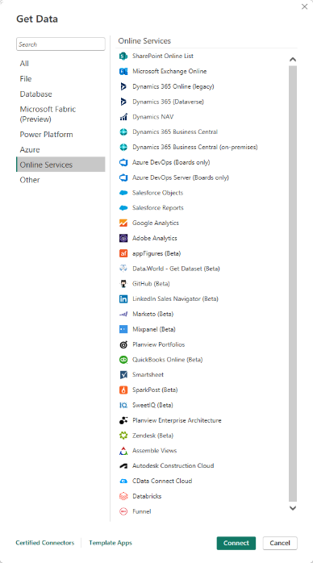
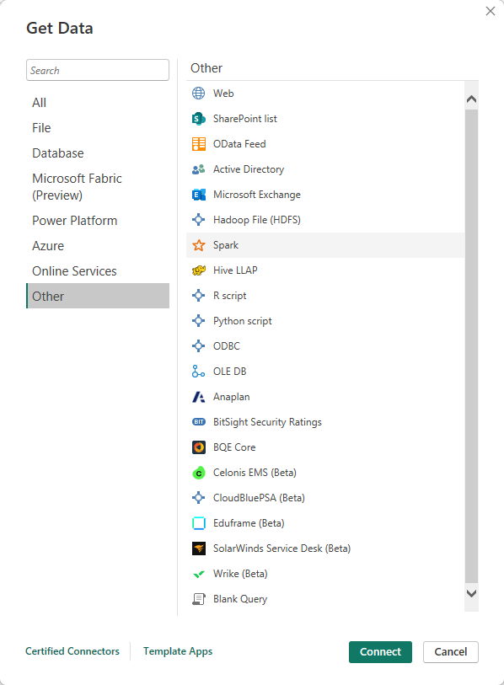
Notes:
Can import data from a wide variety of sources 100+
3/3

Slide 53
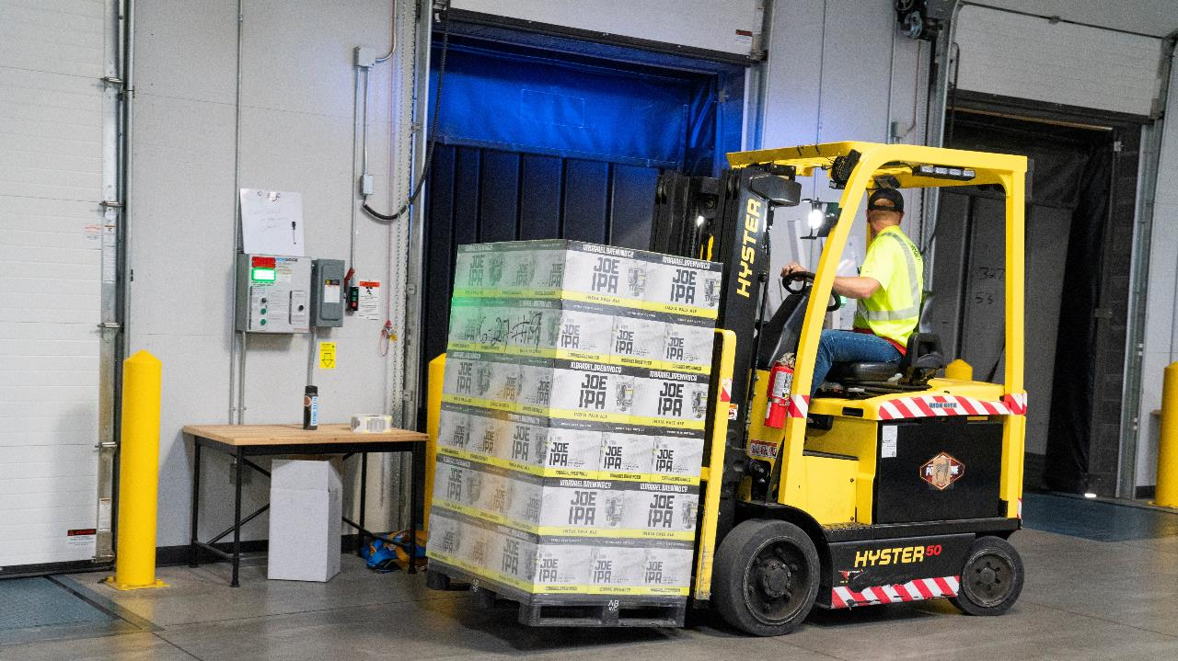
Notes:
Photo by ELEVATE from Pexels
Also get a fantastic ETL tool as well built into Power BI Desktop
Informatica
Alteryx
Talend
QlikView Expressor
Tableau Data Prep
SQL Server Integration Services SSIS

Slide 54

Notes:
Photo by Pixabay from Pexels
There is also a Datawarehousing tool built into Power BI Desktop

Slide 55
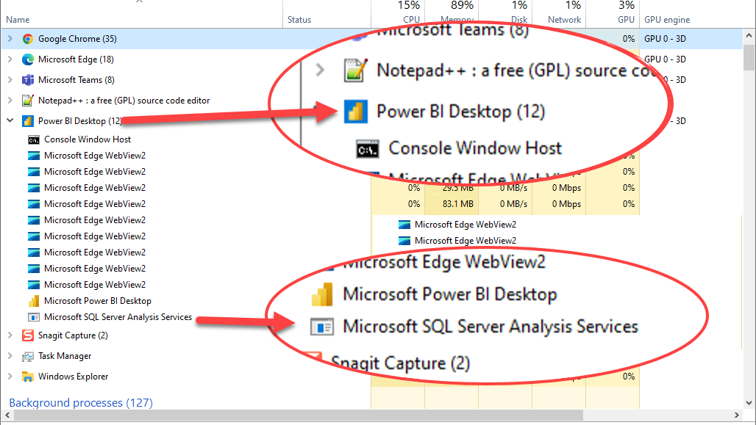
Notes:
Power BI desktop is running an instance of SQL Server Analysis Services

Slide 56

Notes:
Photo by Timur Saglambilek from Pexels
There is some amazing analytics capabilities built into Power BI

Slide 57
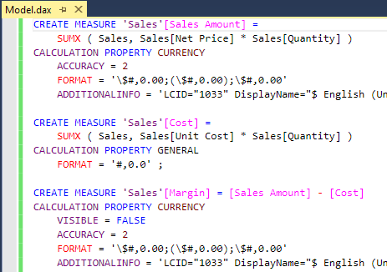
Notes:
DAX is an entire language just for working with data

Slide 58
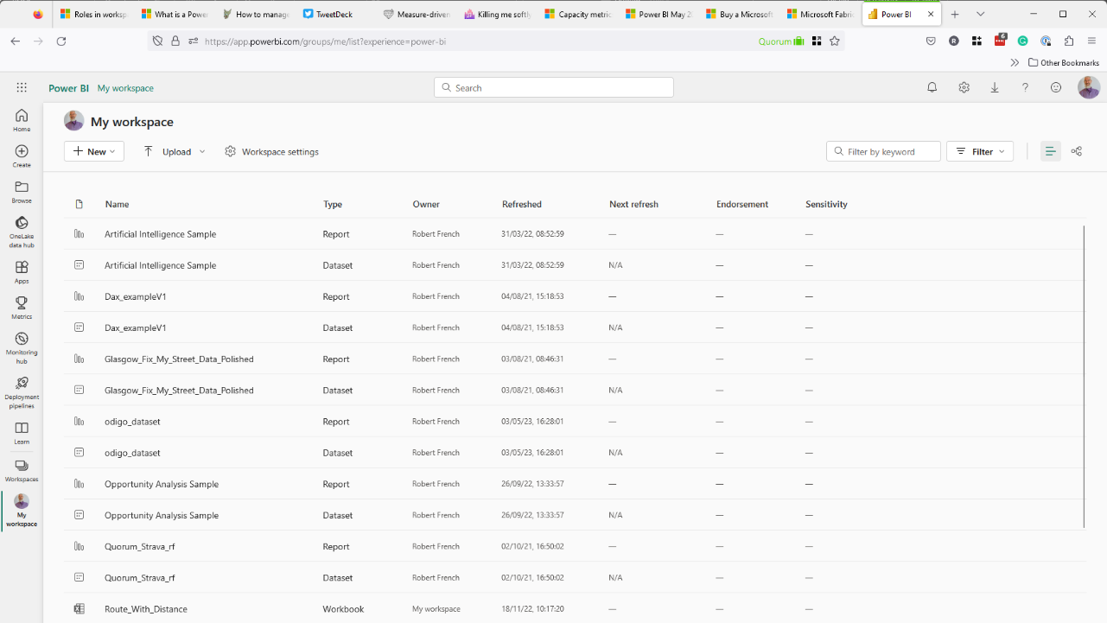
Notes:
You get access to a workspace in the Power BI service for free
A workspace can contain both reports and other entities

Slide 59
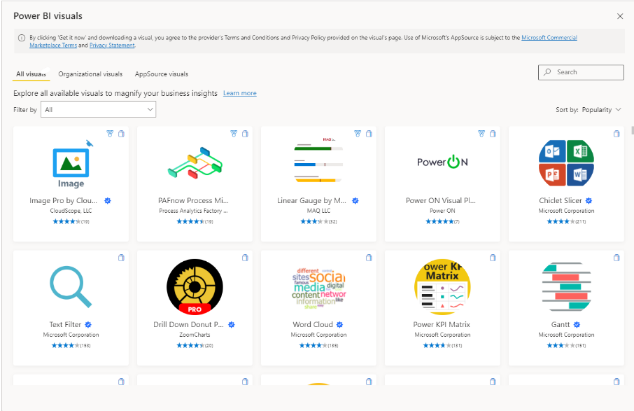

Slide 60

Notes:
Photo by Spencer Davis on Unsplash
It is possible to share the reports freely on the internet

Slide 61

Notes:
Photo by Ben White on Unsplash
Can share desktop files for free with anyone who has the application

Slide 62
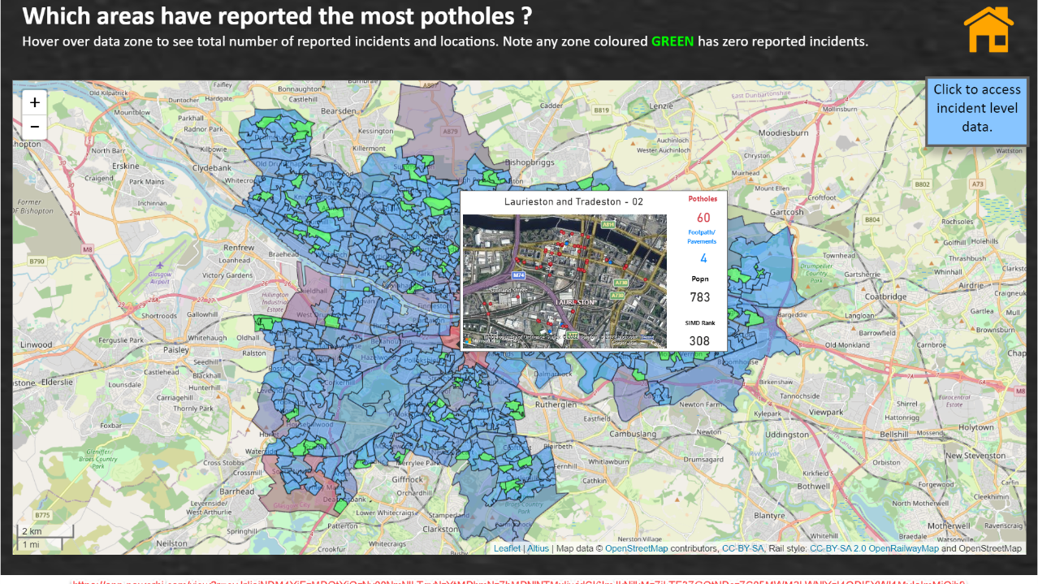
Notes:
https://app.powerbi.com/view?r=eyJrIjoiY2VlMjg1MmQtMzFhZi00NzY1LThjZTUtMWI2MjM5ODFhYjUzIiwidCI6ImJkNjlkMzZiLTE3ZGQtNDczZC05MWM2LWNlYzI4ODI5YWI1MyIsImMiOjh9
Can share reports on the internet for free, there a catch we will discuss that later

Slide 63
Cost = £0.00p

Slide 64
Access to Power BI Service
Own workspace to upload to

Slide 65
Notes:
It allows access to all the access fabric features that account is permitted to access.
If the capacity is running

Slide 66
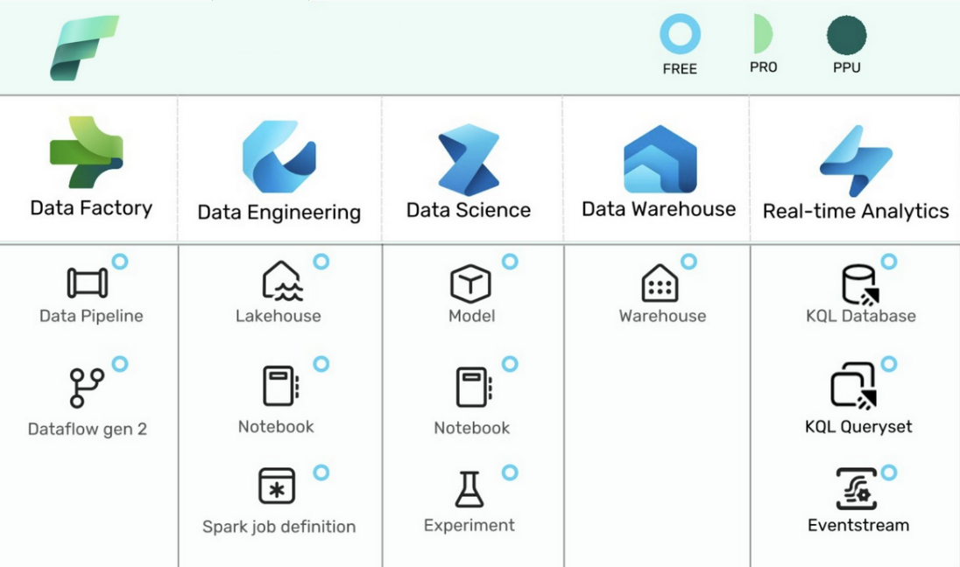
July 2023 – non power bi entities in workspace
Backed by a Fabric Capacity (F-SKU or P SKU)
https://learn.microsoft.com/en-us/fabric/enterprise/licenses#capacity-and-skus

Slide 68
Notes:
https://app.powerbi.com/view?r=eyJrIjoiY2VlMjg1MmQtMzFhZi00NzY1LThjZTUtMWI2MjM5ODFhYjUzIiwidCI6ImJkNjlkMzZiLTE3ZGQtNDczZC05MWM2LWNlYzI4ODI5YWI1MyIsImMiOjh9
Can share the reports this is public so NO SECURITY

Slide 69

Notes:
Photo by chris panas on Unsplash

Slide 70
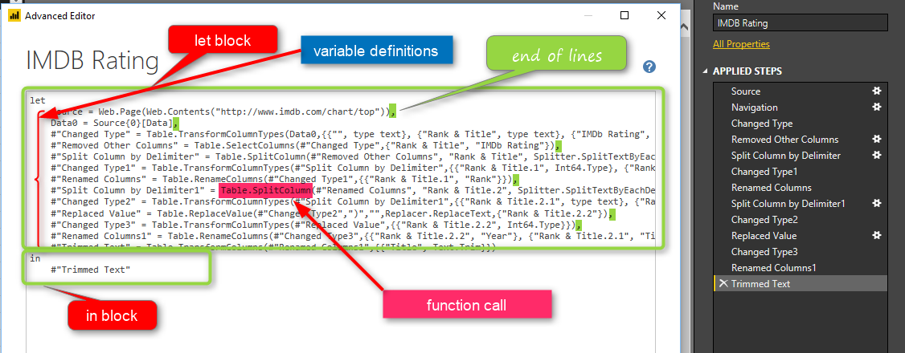
https://radacad.com/basics-of-m-power-query-formula-language
Notes:
There is not just one language new in Power BI desktop there is TWO LANGUAGES
DAX and M (or Power Query Language) both with different purposes and functions

Slide 71

Notes:
There is not support, there is lots o

Slide 72

This Photo by Unknown Author is licensed under CC BY
Notes:
There is a very large community offering support

Slide 74


Slide 75
Cost
£8.20 per month
£98.4 per year
(At June 2023)

Slide 76
User license
Notes:
Personal license – to allow anyone to ride on a bus in Glasgow you have purchase a ticket, this could be a season ticket so you can ride at any time. Only one person at a time can use that ticket though

Slide 77
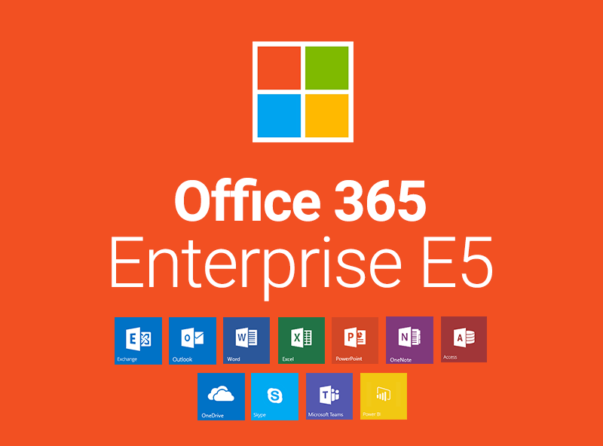
Notes:
Included with Office 365 E5 licence

Slide 78
Notes:
It allows access to all the access fabric features that account is permitted to access.
If the capacity is running

Slide 79
Notes:
What are the upsides of Power BI Pro

Slide 80
Notes:
Photo by Spencer Davis on Unsplash
You can share reports with other people if they have a PowerBI Pro Licence

Slide 81
Notes:
Photo by chris panas on Unsplash
Can share securely using Office 365 or Power BI Service IF the other user has POWER BI PRO

Slide 82
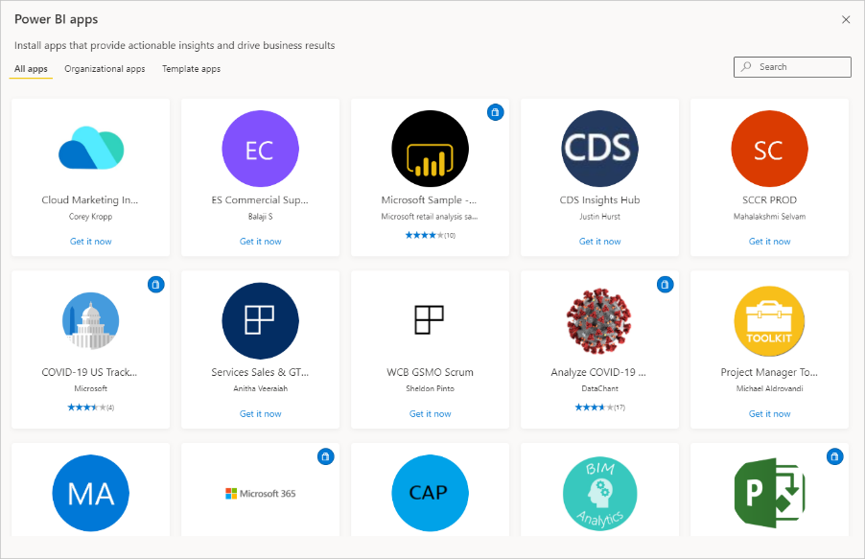
Notes:
Can use and publish Power Bi Apps – these4 are free apps typicall
Apps are dashboards and reports all pre-packaged ready to download and use – can get them in the AppSource
Twitter sentiments
Facebook Adverts
Sage 300
YouTube Analytics Report
Google Analytics Reports

Slide 83
Power BI Apps
<>
PowerApps

Slide 84

Notes:
Can use Office 365 security to grant permissions to view the reports including using Office 365 groups

Slide 85

Power BI
Data gateway
Notes:
Can use data gateways to access on prem sources using data gateway

Slide 86


Slide 87
Access to Power BI Service
Own workspace to upload to
8 refreshes per day
Dataset incremental refresh
Securely share with other pro license users

Slide 89

Notes:
Photo by Laura Dewilde on Unsplash
The reports are hosted on a shared server when published to PowerBi.com so if its busy then could be slower then expected.

Slide 90
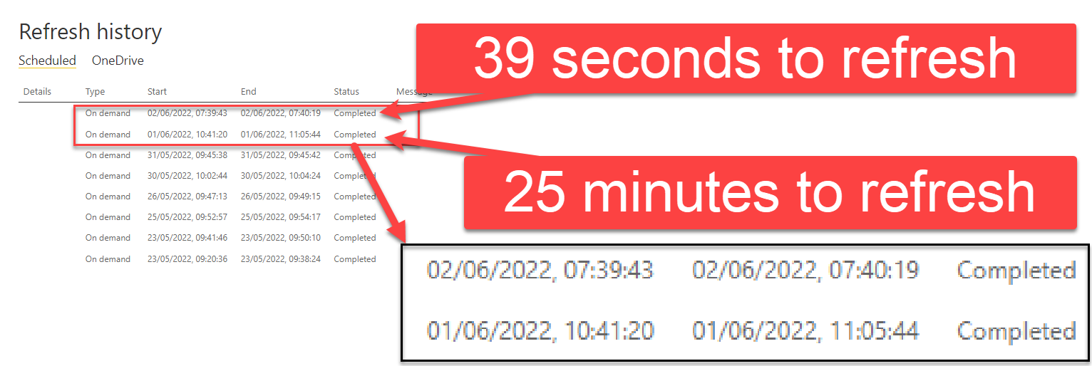
Same report refreshed
In Power BI Pro workspace

Slide 91

No Pro License No Secure Sharing
Notes:
Photo by Elaine Casap on Unsplash
The person you want to share with must have a Power BI Licence if want to share securely

Slide 92
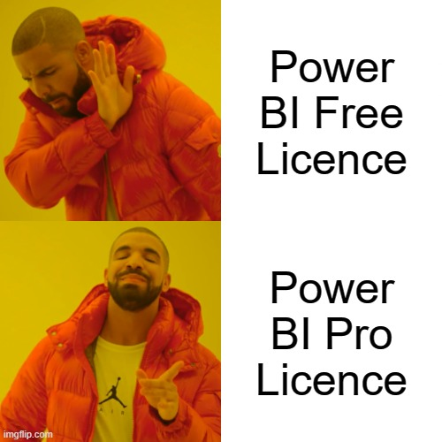

Slide 93
Power BI Premium Per User
Notes:
Power Bi Per User Licence
Photo by Papaioannou Kostas on Unsplash

Slide 94



Slide 95
Cost
£16.40 per month
£196.80 per year
(At June 2023)

Slide 96
User license
Notes:
Personal license – to allow anyone to ride on a bus in Glasgow you have purchase a ticket, this could be a season ticket so you can ride at any time. Only one person at a time can use that ticket though

Slide 97
Notes:
What are the upsides of Power BI Pro

Slide 98


Many features of Power BI Premium
Notes:
Photo by Karolina Grabowska from Pexels

Slide 99

Notes:
Photo by Ivan from Pexels
Larger model size – 100 GB compared to 10GB for Pro

Slide 100

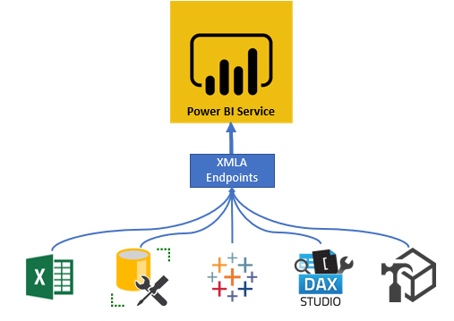

Slide 101

Notes:
Photo by Clay LeConey on Unsplash
There are so many other features

Slide 102
Notes:
It allows access to all the access fabric features that account is permitted to access.
If the capacity is running

Slide 103
Access to Power BI Service
Own workspace to upload to
48 refreshes per day (more if reqd)
Dataset and Dataflow incremental refresh
Securely share with other PPU license users
Access to Workspaces backed by Pro license
AI & ML capabilities
100GB dataset size.

Slide 105
Content sharing
Notes:
Photo by Elaine Casap on Unsplash
The person you want to share with must have a Power BI Licence if want to share securely

Slide 106


Slide 107
 |  | Licence Type can view / access content
 | Licence Type creating content | Pro | Premium Per User | Premium Per Capacity user (no named licence)
Create content with this licence in a workspace | Pro | Yes | Yes | No
 | Premium Per User | No | Yes | No
 | Premium Per Capacity | Yes | Yes | Yes
https://docs.microsoft.com/en-us/power-bi/admin/service-premium-per-user-faq

Slide 108



Pro account
Workspace
Free
PPU
Pro

Slide 109
PPU account
Workspace
Free
PPU
Pro

Slide 110
Power BI Embedded
Notes:
https://enthusiasthome.com/diy-entertainment-center/

Slide 111
Capacity License
Notes:
What if your company wants to transport 60, or 100 people regularly. More people it becomes cheaper to rent the entire bus

Slide 112

Notes:
Photo by Miguel Á. Padriñán from Pexels

Slide 113

This Photo by Unknown Author is licensed under CC BY-SA

Slide 114
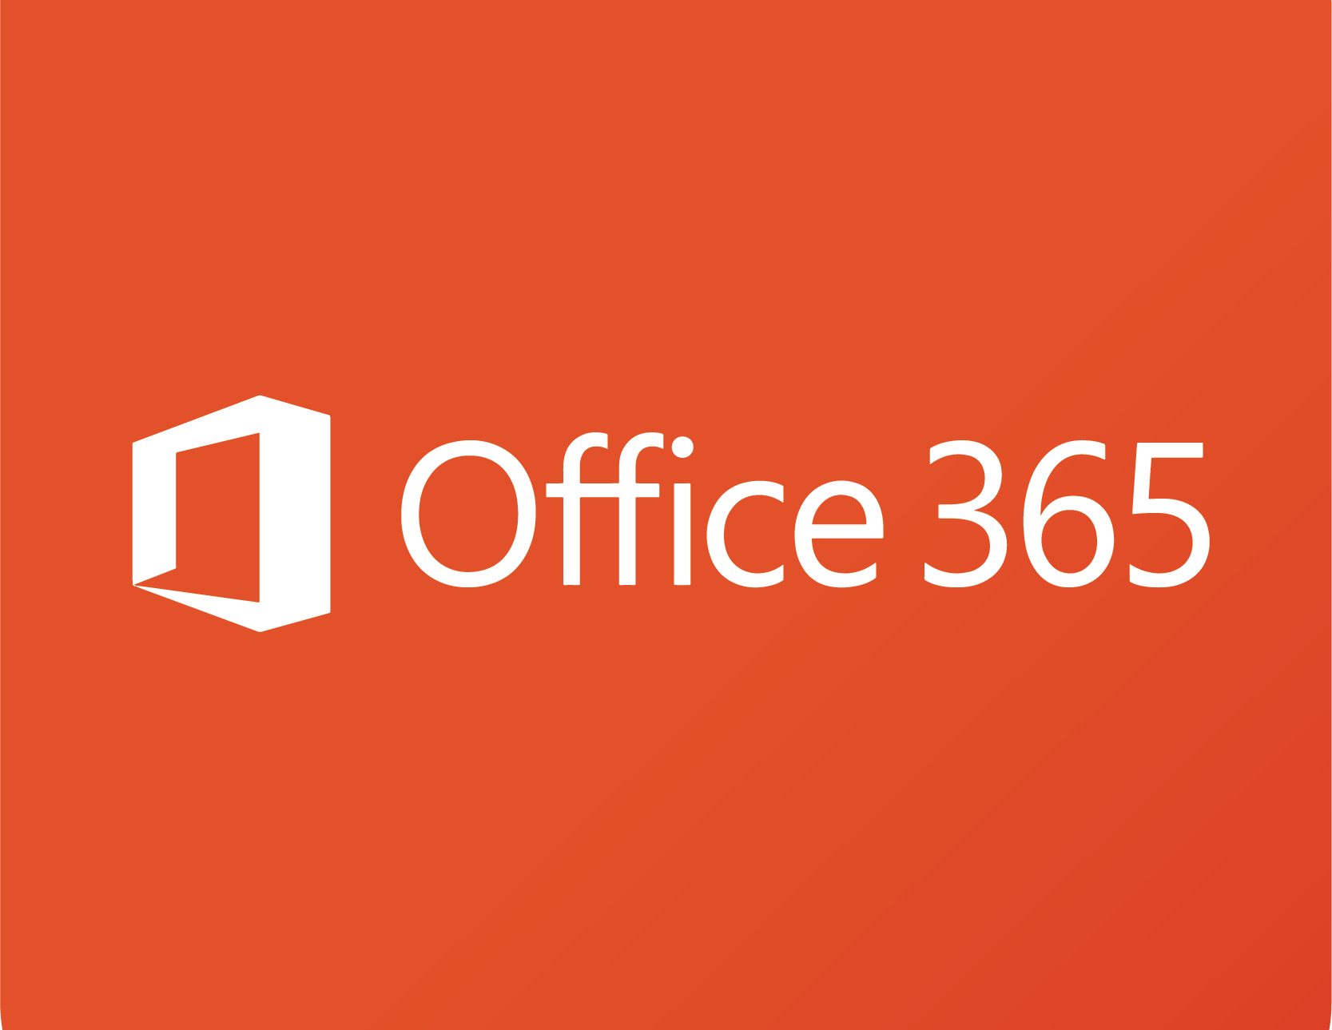
EM- SKU
Notes:
Embedding

Slide 115
Notes:
What are the upsides of Power EM - SKUe

Slide 116



Notes:
This easily allows an organisation to embed Power BI into SharePoint online and Microsoft teams. - Fantastic for an organizational use of Office

Slide 117
Within an organization
(Office 365 tenant)
Notes:
Photo by chris panas on Unsplash
Can share securely using Office 365 or Power BI Service IF the other user has POWER BI PRO

Slide 119
Notes:
Photo by Ben White on Unsplash
Can share desktop files for free with anyone who has the application

Slide 120
Name | Dedicated infrastructure | Virtual Cores | Memory (GB) | Peak Renders /Hr | Cost per month | Annual
EM1* | No | 1 | 3 | 1-300 | Approx. £470 | £5.6k
EM2* | No | 2 | 5 | 301-600 | Approx. £935 | £11.2k
EM3 | Yes | 4 | 10 | 601-1200 | £1,881 | £22.5k
* These products are only available to volume license customers only, contact Microsoft to confirm pricing only shown for guidance.
Notes:
Monthly prices - https://jlsql.blog/2018/01/30/power-bi-embedded-sku-differences-and-cost-breakdowns/
https://whitepages.unlimitedviz.com/2017/09/understanding-the-power-bi-capacity-based-skus/
Also cannot get any larger than A3 sku

Slide 121
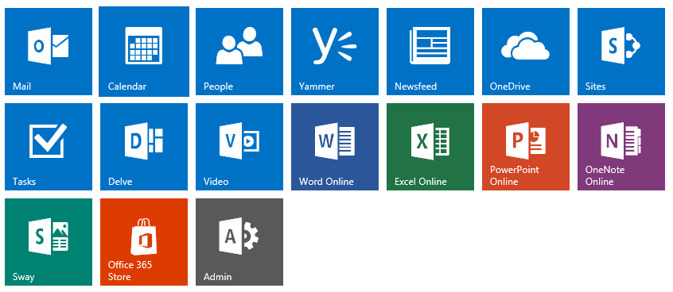
Notes:
This has be purchased via the Office 365 portal
If not a volume licence customer can only purchase EM-3 SKU

Slide 122

This Photo by Unknown Author is licensed under CC BY-SA-NC

Slide 123

Notes:
Embedding

Slide 124
Capacity License
Notes:
What if your company wants to transport 60, or 100 people regularly. More people it becomes cheaper to rent the entire bus

Slide 125

Notes:
Photo by Christina Morillo from Pexels
Primarily intended for ISV to integrate into their own systems

Slide 126
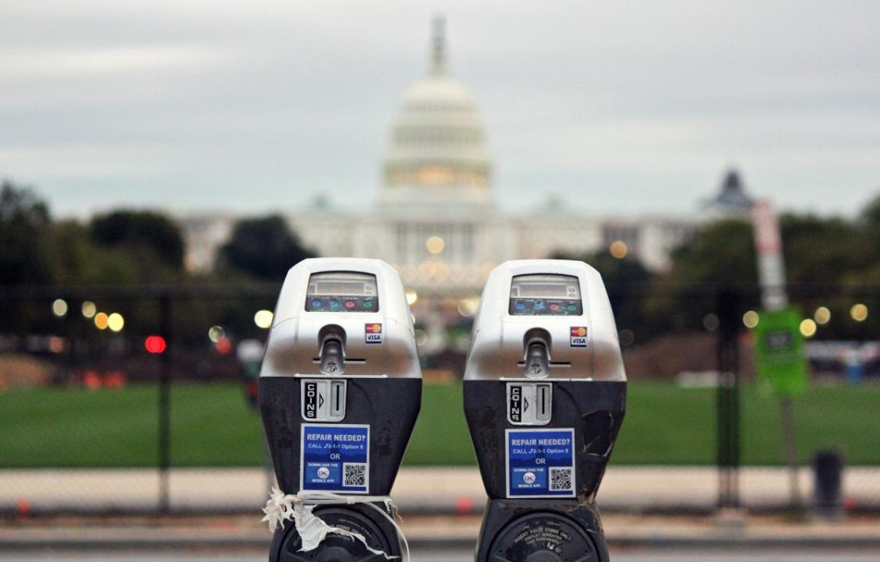
This Photo by Unknown Author is licensed under CC BY-NC
Notes:
The payment model is quite simple its pay as you go.

Slide 127


= £0.00
https://azure.microsoft.com/en-us/pricing/details/power-bi-embedded/
Notes:
This Photo by Unknown Author is licensed under CC BY

Slide 128

£
£
Scale up
Scale Down
Notes:
Does anyone use power later at night?
https://docs.microsoft.com/en-gb/power-bi/developer/embedded/azure-pbie-scale-capacity
A scaling operation can take about a minute. During this time, the capacity will not be available. Embedded content may fail to load.

Slide 129
Share securely with anyone
Notes:
Photo by chris panas on Unsplash
Can share securely using Office 365 or Power BI Service IF the other user has POWER BI PRO

Slide 131
Name | Dedicated Infrastructure | Virtual Cores | Memory (GB) | Peak Renders /Hr | Cost per hour
A1 | No | 1 | 3 | 1-300 | £0.819
A2 | No | 2 | 5 | 301-600 | £1.631
A3 | Yes | 4 | 10 | 601-1,200 | £3.269
A4 | Yes | 8 | 25 | 1,201-2,400 | £6.545
A5 | Yes | 16 | 50 | 2,401-4,800 | £13.097
A6 | Yes | 32 | 100 | 4,801-9,600 | £26.200

Slide 132
Notes:
With the azure embedded SKU you cannot embed EASILY in to sharepoint on line or teams

Slide 133
Can only purchase via Azure Portal

Slide 134

Notes:
Photo by Mikael Seegen on Unsplash

Slide 135
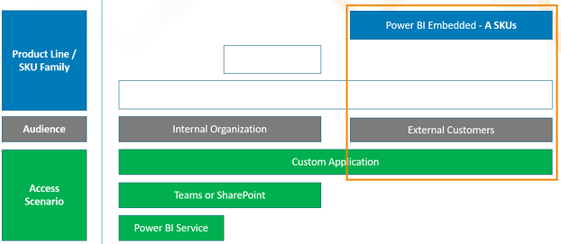
"App owns data"
https://www.bluegranite.com/blog/choosing-between-pbi-premium-or-embedded
Notes:
https://www.bluegranite.com/blog/choosing-between-pbi-premium-or-embedded

Slide 136

Notes:
Photo by Flex Point Security on Unsplash

Slide 137
Power BI Premium
Notes:
Photo by Jp Valery on Unsplash

Slide 138
Capacity License
Notes:
What if your company wants to transport 60, or 100 people regularly. More people it becomes cheaper to rent the entire bus

Slide 139
Notes:
What are the upsides of Power BI Free

Slide 140
Share securely with anyone
Notes:
Photo by chris panas on Unsplash
Can share securely using Office 365 or Power BI Service IF the other user has POWER BI PRO

Slide 141
Premium
Workspace
Pro
Free
PPU

Slide 142
Notes:
Photo by Ivan from Pexels
Larger model size 400GB compared to 100GB for PPU
Up to 48 refreshes a day

Slide 144

Notes:
Photo by Pixabay: https://www.pexels.com/photo/earth-wallpaper-41953/
Multi-geo deployment management

Slide 145

Notes:
Photo by Karsten Würth on Unsplash
Auto scale add-on availability

Slide 146

Notes:
Photo by Pixabay: https://www.pexels.com/photo/brass-ornate-vintage-key-on-black-computer-keyboard-39389/
power bu Bring your own key (BYOK)

Slide 147
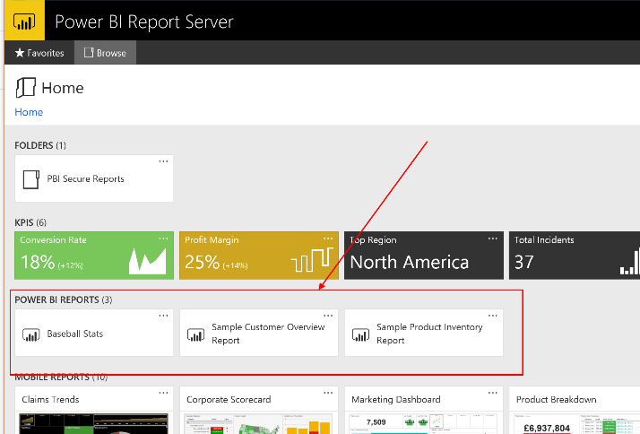

Slide 148

This Photo by Unknown Author is licensed under CC BY-SA

Slide 150
Name | Virtual Cores | Memory (GB) | Backend Cores | Frontend Cores | Peak Renders /Hr | Cost per month | Annual
P1 | 8 | 25 | 4 | 4 | 1,201-2,400 | £4,926.72 | £59k
P2 | 16 | 50 | 8 | 8 | 2,401-4,800 | £9858.36 | £118k
P3 | 32 | 100 | 16 | 16 | 4,801-9600 | £19,721.64 | £236k
P4 | 64 | 200 | 32 | 32 | 9,601-19,200 | £39,448.20 | £474k
P5 | 132 | 400 | 64 | 64 | 19,201-38,400 | £78901.32 | £947k
Notes:
Out of date costs

Slide 151

Notes:
Photo by Aziz Acharki on Unsplash

Slide 152

Notes:
Photo by Call Me Fred on Unsplash

Slide 153

Notes:
Photo by Ekaterina Grosheva on Unsplash

Slide 154
…..the story
so far…..

Slide 155
Name | Capacity Units | A-SKU | P-SKU | Cost per hour
F2 | 2 | N/A | N/A | £0.309
F4 | 4 | N/A | N/A | £0.617
F8 | 8 | A1 | N/A | £1.235
F16 | 16 | A2 | N/A | £2.470
F32 | 32 | A3 | N/A | £4.939
F64 | 64 | A4 | P1 | £9.879
F128 | 128 | A5 | P2 | £19.757
F256 | 256 | A6 | P3 | £39.515
F512 | 512 | A7 | P4 | £79.029
F1024 | 1024 | A8 | P5 | £158.058
F2048 | 2028 | N/A | N/A | £316.117

Slide 156

Notes:
Photo by Andrea Piacquadio: https://www.pexels.com/photo/close-up-photo-of-shocked-woman-with-brown-curly-hair-3764398/
This next table made me surprised

Slide 157
Scenario | Azure (F-SKU) | Azure (A-SKU) | Office (P- SKU)
Embed for Customers (app owns Data)
Embed for your Organisation (app owns Data)
Microsoft 365 Apps (Embed in Teams Embed in Share Point Embed in Power Point)
Secure URL Embedding (embed from Power BI Service)
https://learn.microsoft.com/en-us/power-bi/developer/embedded/embedded-capacity#which-sku-should-i-use
Notes:
https://learn.microsoft.com/en-us/power-bi/developer/embedded/embedded-capacity#which-sku-should-i-use

Slide 158

Notes:
Photo by <a href="https://unsplash.com/@mrthetrain?utm_source=unsplash&utm_medium=referral&utm_content=creditCopyText">Joshua Hoehne</a> on <a href="https://unsplash.com/photos/Nsaqv7v2V7Q?utm_source=unsplash&utm_medium=referral&utm_content=creditCopyText">Unsplash</a>

Slide 159

Notes:
Photo by <a href="https://unsplash.com/@stayandroam?utm_source=unsplash&utm_medium=referral&utm_content=creditCopyText">Gemma Evans</a> on <a href="https://unsplash.com/photos/zj475haUy2M?utm_source=unsplash&utm_medium=referral&utm_content=creditCopyText">Unsplash</a>

Slide 160
Reserved instances
(RI-SKU?)

Slide 161
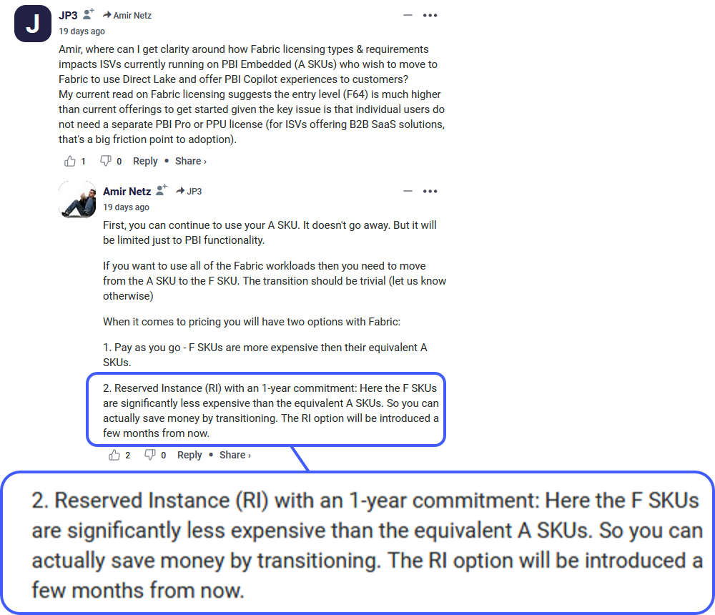

Slide 162





Slide 163

Notes:
Photo by Brendan Church on Unsplash
What are the other choices? Or do you have to take what Microsoft offers and be stratified with that?

Slide 164
Notes:
Photo by Diana Parkhouse on Unsplash

Slide 165

Notes:
Photo by Nick Fewings on Unsplash

Slide 166


Slide 167
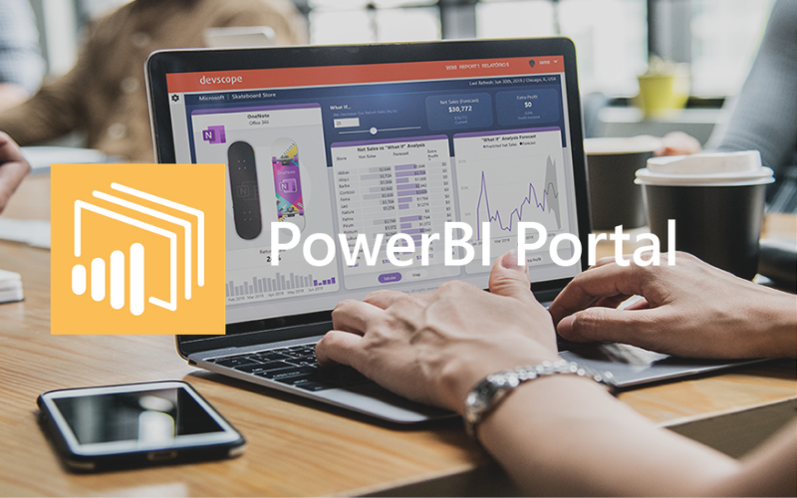

Slide 168
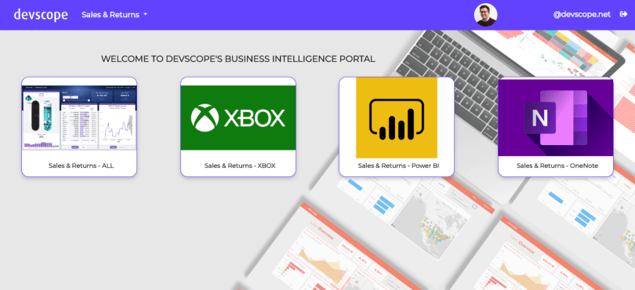

Slide 169

Notes:
Photo by Anders Jildén on Unsplash
Before we get to some Total Cost Of Ownership costs
Want to ask the question do you leave the lights on in your building if no on is using them?

Slide 170



Slide 171

Share securely with anyone
Notes:
Photo by chris panas on Unsplash
Can share securely using Office 365 or Power BI Service IF the other user has POWER BI PRO

Slide 172


Slide 173

Notes:
Photo by Adrian Bar on Unsplash
There are several components to this solution, so lets look at them before getting to the bottom line

Slide 174




4 required components
Notes:
SQL server database
Azure Blob Storage
2 X App Services
PowerBI A SKU

Slide 175

€ 3499.00 per annum
(£3.2k approx.)

Slide 176
Power BI SKU | Total Monthly cost | Total Yearly Cost
A1 | £564 | £6,759
A2 | £728 | £8,726
A3 | £1,058 | £12,693
A4 | £1856.58 | £22,278.96
P1 | £4,927 | £59,120 (for comparison only)
Pricing includes
Dev Scope Power Portal – 12 month contract
Azure SKU running for 10 hours per day, Monday to Friday Only
Azure Service never paused
Azure SQL Database
2 x Azure App Services
Azure storage service

Slide 177

Really ? No, I do not believe it…..
Notes:
Photo by Sean Nyatsine on Unsplash

Slide 178

Notes:
Photo by Kelly Sikkema on Unsplash

Slide 179
Working days in a year
52 weeks
5 working days
52 x 5 = 260
Working days per month
260 / 12 = 21.6667
22 working days per month

Slide 180
Devscope Power BI Portal
Annual cost = 3,499.00 €
Annual cost = £3,200.00
Monthly cost = £ 266.67

Slide 181
£13.72 per month
£15.22 per month
£102.29 per month
£165.30 per month (220 hours)
1 X A1 SKU
4 required components

Slide 182

Oi’ beardy
Show ‘em the
calculator

Slide 183
 | Cost Per Month
DevScope Power BI Portal | £ 266.67
Azure SQL Database | £13.72
App Service (x2) | £111.49
Storage Account | £16.60
Power BI A4 Embedded 220 hours usage | £1439.90
Power BI Pro Licence x 1 | £8.20
Total Monthly Estimated Cost | £1856.58
Total Yearly Estimated Cost (as of May 2022) | £22,278.96
https://azure.com/e/9b291a23fad540d6a6d928234774b706

Slide 184

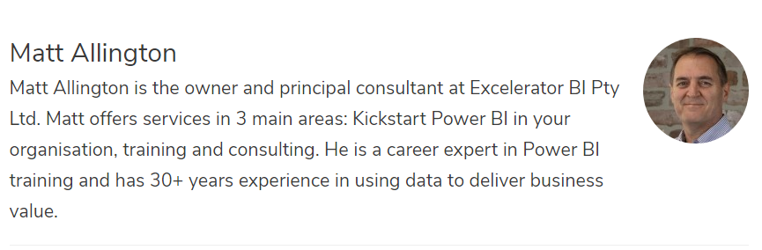
https://exceleratorbi.com.au/

Slide 185
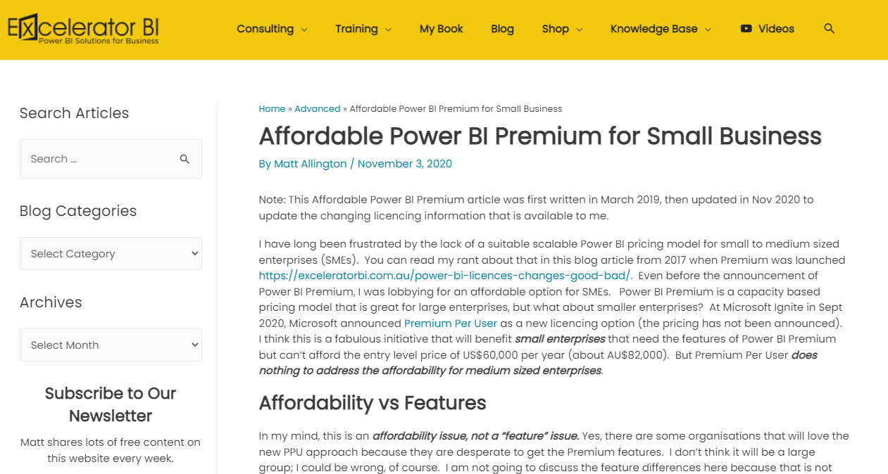
https://exceleratorbi.com.au/affordable-power-bi-premium-for-small-business/

Slide 186
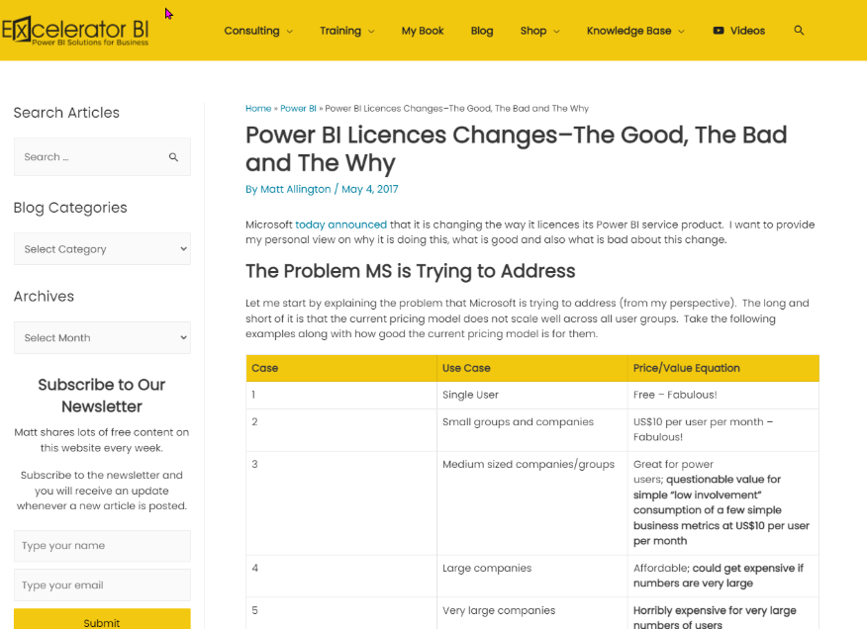
https://exceleratorbi.com.au/power-bi-licences-changes-good-bad/

Slide 187
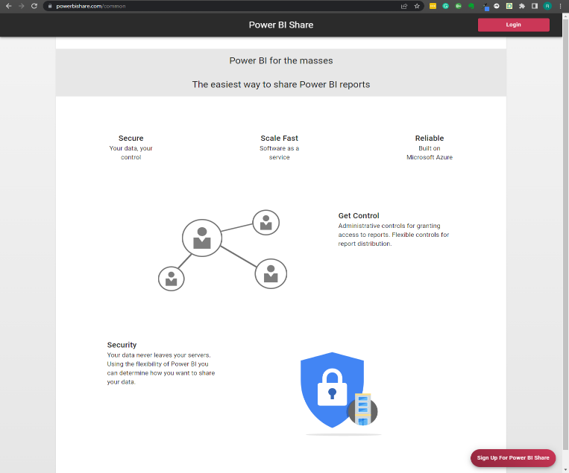
https://www.powerbishare.com
Notes:
Hi Matt, I was interested in confirming the details of the pricing for www.powerbishare.com.
$2000 set up cost, this is one-off payment? $2 per named user /login per month - is this an annual cost that is payable every year? The only other cost for an organisation that might want to use this service. They are required to have an A-SKU, and at least one Power BI Pro licence. From what I see there are no other requirements?
If they want to start/stop the Capacity, they will need some power automate credits and there is a small cost for that. It should be less than $20 per month.

Slide 188
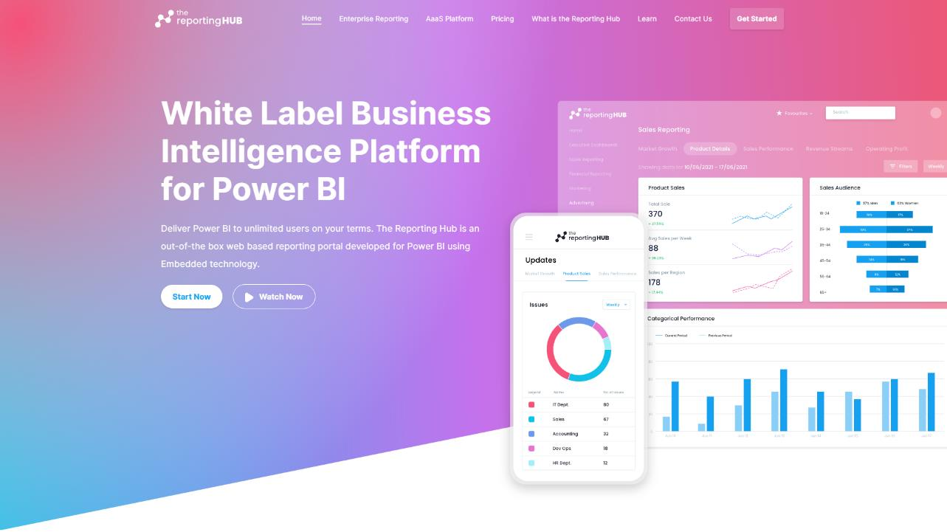
https://thereportinghub.com/

Slide 189
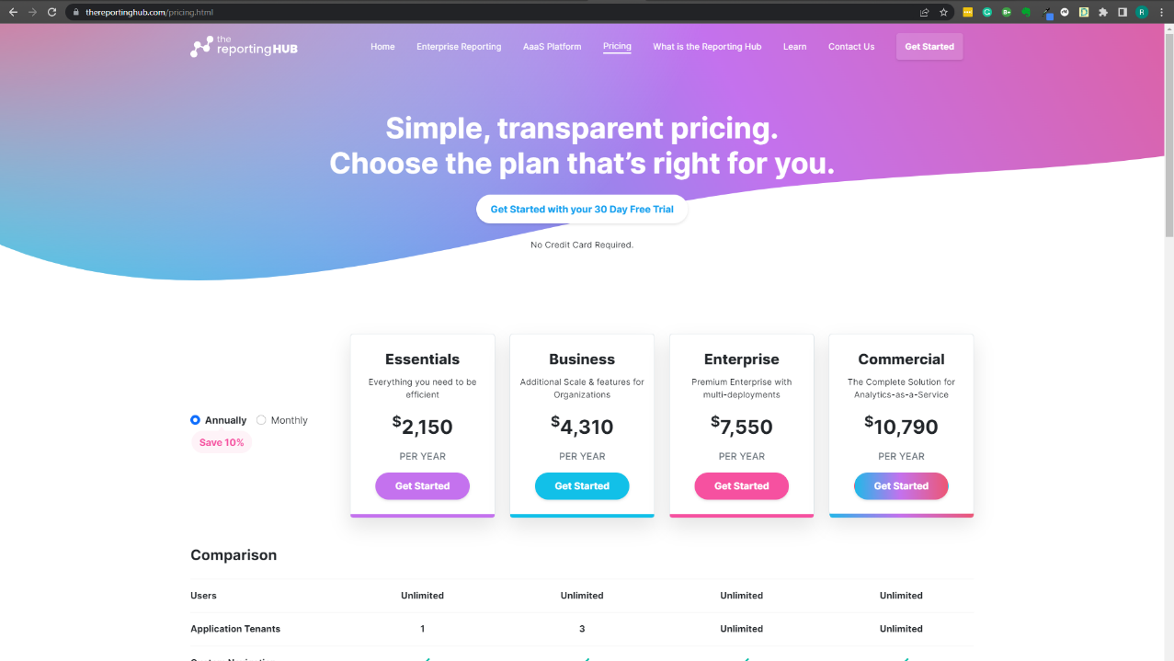

Slide 190
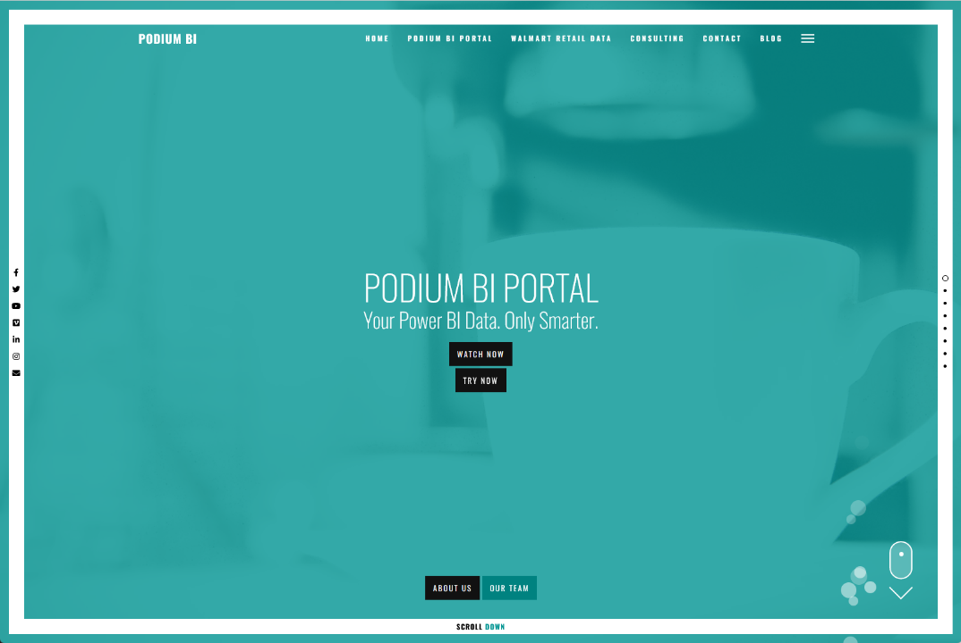
https://www.podiumbi.com/powerbi-reporting-software/

Slide 191
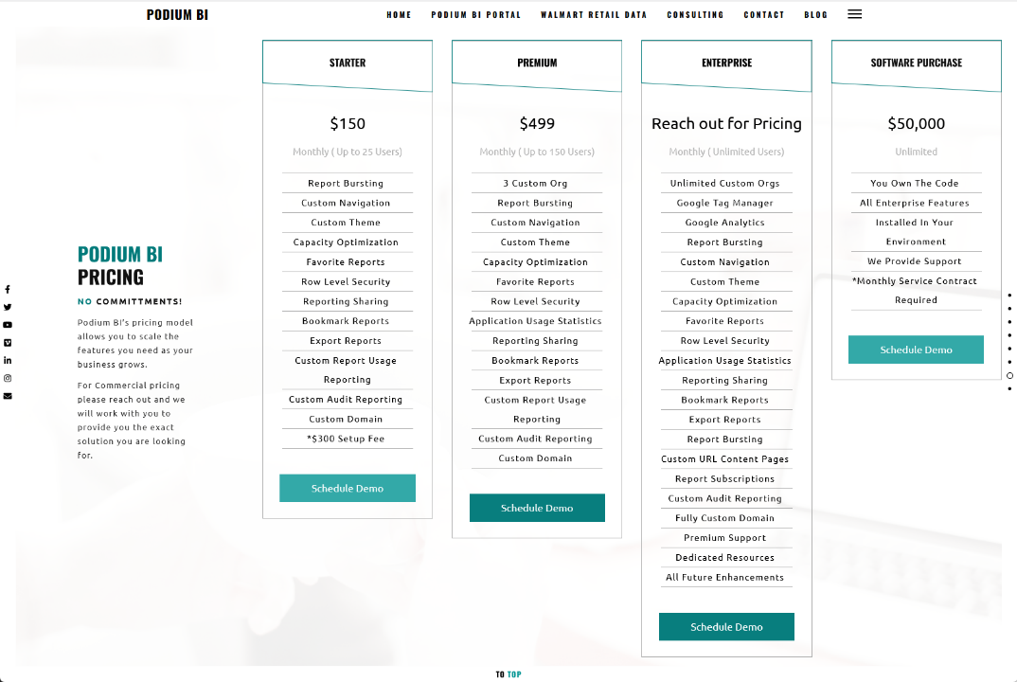

Slide 192

Notes:
Photo by Jake Young on Unsplash

Slide 193

TL;DNL -Too long did not listen!
Notes:
Photo by Mariam Soliman on Unsplash
Fair enough I would get bored if I heard me talking for the length of time

Slide 194

Notes:
Photo by Milada Vigerova on Unsplash

Slide 195

Notes:
Photo by Ann H from Pexels

Slide 196
User license
Notes:
Personal license – to allow anyone to ride on a bus in Glasgow you have purchase a ticket, this could be a season ticket so you can ride at any time. Only one person at a time can use that ticket though

Slide 197
Notes:
Photo by William White on Unsplash

Slide 199


Slide 200
Capacity License
Notes:
What if your company wants to transport 60, or 100 people regularly. More people it becomes cheaper to rent the entire bus

Slide 201
Power BI Embedded
Notes:
https://enthusiasthome.com/diy-entertainment-center/

Slide 202
EM- SKU
Notes:
Embedding
The office EM-Sku makes it easy to share reports within an organization
Have to sign up to a minimum of a 12 month contract which is a fixed price
CANNOT SHARE WITH EXTERNAL CUSTOMERS – although the inviting external users to the Azure AD MIGHT work?

Slide 203
Notes:
Azure Embedded is another option
Scalable not fixed contract requires more work to set up and maintain
Does have an advantage certain use cases

Slide 204
Power BI Premium
Notes:
Photo by Jp Valery on Unsplash

Slide 205

Notes:
There are other choices though !
If you are prepared to do some work and think outside the Box

Slide 206
Notes:
Photo by Diana Parkhouse on Unsplash

Slide 207
Notes:
Dev Scope Power BI portal –
Sits on top of the Azure embedded SKU so costs more then implementing just A-SKU
Offers ability to share with any customer
Offers built in security and customisation
Could be cheaper then Premium and yet allow sharing with external customers

Slide 208
https://www.powerbishare.com

Slide 209
https://thereportinghub.com/

Slide 210

Notes:
Photo by Jan Baborák on Unsplash
Who is in control of the costs with the last three options?
Who is in the driving seat controlling the costs.

Slide 211

Notes:
Photo by fauxels from Pexels
Not interest in selling to you a solution which does not work for you, what I would like to do is find a solution which meets your specific needs. So LETS HAVE A CONVERSTATION

Slide 212
Trust, but verify.
Ronald Regan
Notes:
Photo by Cytonn Photography on Unsplash

Slide 213
Robert French
Data Shepherd,
Data Plumber ,
Data Dance Teacher
Email -
Robert.French@qnrl.com
@sqlbobscot
#DressUpFriday
Linked In - https://www.linkedin.com
/in/rwlpfrench/
Website - https://www.qnrl.com/

Slide 214

Notes:
Photo by Wilhelm Gunkel on Unsplash

Slide 215

Notes:
Photo by Edwin Andrade on Unsplash

